Slide 1
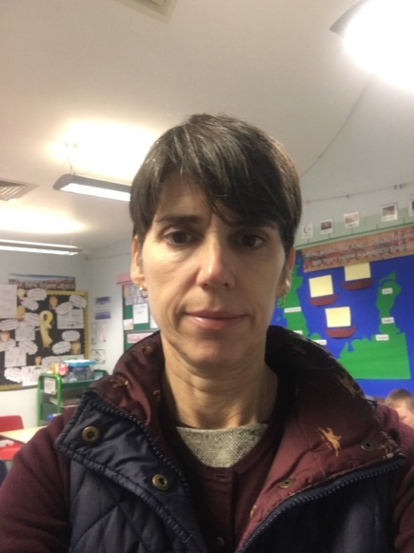
SAFEGUARDING: Designated Professionals
If you have a concern about a child’s safety or wellbeing, speak to one of the school’s Designated Professionals:
LAURA WATTS
Designated Safeguarding Lead
MELISSA MORISON
Deputy Safeguarding Lead

